Slide 1
It’s All About Energy
Energy is the ability to do work.
Living things depend on energy to carry out processes such as transport, cell division, movement, digestion.
Where does this energy come from? Simply, it comes from food.
Autotrophs – organisms that are able to use light energy from the sun to produce food.
Heterotrophs – obtain energy from the food they eat.

Slide 2
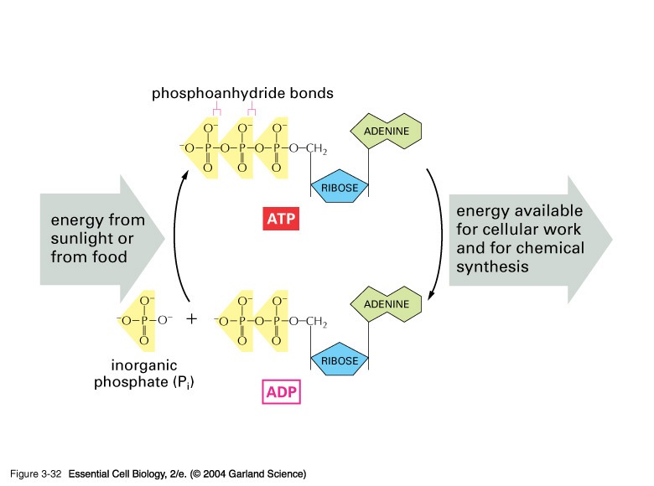
Cell activities need energy in the form of ATP. Cells must be able to convert the energy trapped in the chemical bonds of glucose into ATP.

Slide 3
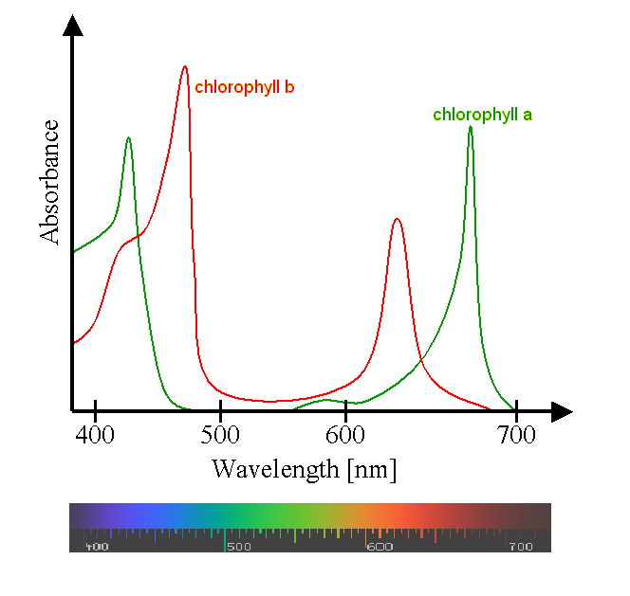
In order for plants to carry out photosynthesis, they need water, carbon dioxide, light and chlorophyll.

Slide 4
Factors that Affect the Rate of Photosynthesis
availability of water
temperature (Enzymes for photosynthesis function best between 0° and 35°C)
intensity of light

