Slide 1
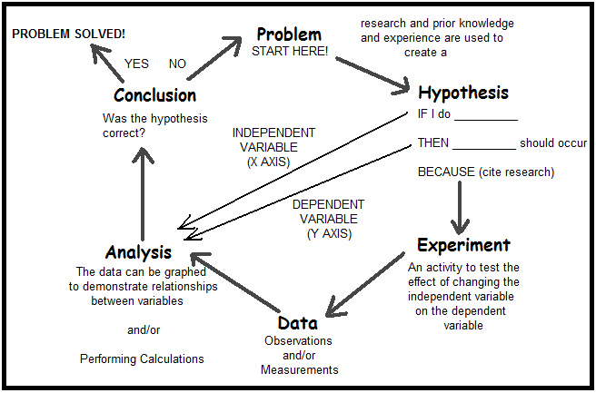

Slide 2
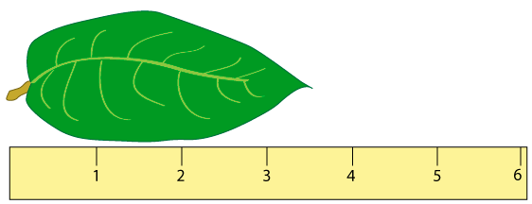

Slide 3
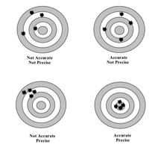

Slide 4
Rules for Determining Precision
If the measurement has a decimal point in it, the precision of the measurement is the furthest place to the right.
Example 23.004 cm Precise to thousandths
2. If the measurement does not have a decimal point in it, the precision is the place where either the rightmost integer is, or where a zero with a line over it is.
Example 2300 km Precise to hundreds

Slide 5
Rule for Significant Figures
The number of significant figures in a measurement equals the total number of digits from and including the first (leftmost) integer in the measurement all the way to the limit of precision of that measurement.
Examples
23.285 cm 5 significant figures
8000 sec 1 significant figure
40. L 2 significant figures
2300 g 2 significant figures
200.0 ____ significant figures
0.713 kg ____ significant figures
0.09053 kJ ____ significant figures

Slide 6
How do you round answers in calculations?
Addition and Subtraction
The answer can only be as precise as the least precise of the measurements to be added or subtracted. The answer must be rounded to the place of precision of the least precise of the measurements. Look for the number that’s least precise and round to that place.
Example
33.5 cm + 7.88 cm + 0.977 cm = 42.357 cm → 42.4 cm
Practice
23000 km + 8.7 km = ___________ → __________
6700 mL - 78.7 mL = ____________ → __________

Slide 7
Multiplication and Division
The answer can contain only as many significant figures as the measurement with the least number of significant figures.
Round to the fewest sig figs, counting from the leftward side.
Example
67.23 cm x 9.22 cm = 619.584 cm² → 620. cm²
Practice
200 cm x 3.333 cm = _________ → ___________
30 g / 3 mL = ___________ → _____________

Slide 8
Measurement and the Metric System
The basis of all science lies in the ability to measure quantities. We use the Systeme International (SI) and its derivatives because scientist all over the world express measurements in metric units.
There are seven fundamental quantities upon which all measurement is based.
1. Length
The unit of length is the _______________ which is approximately ______ inches. The following subdivisions of the meter are used in chemistry:
Picometer (pm) = 10⁻¹² meter
Nanometer (nm) = 10⁻⁹ meter
Millimeter (mm) = 10⁻³ meter
Centimeter (cm) = 10⁻² meter
Decimeter (dm) = 10⁻¹ meter

Slide 9
2. Mass
The unit of mass is the ______________ which has an approximate weight on earth of 2.2 pounds. Mass and weight are not the same quantity. Mass is the ________________
__________________________________, while weight is the force with which gravity attracts matter. In chemistry we will also use the gram as a unit of mass.
3. Temperature
Temperature measures the ________________ of an object. The SI unit of temperature is the Kelvin (K). In chemistry we also use the Celsius temperature scale (°C).
°C = K – 273.15
4. Time
The unit of time is the second (s). In chemistry, we also use the familiar minute (min), hour (h), day (d), and year (y) as units of time.

Slide 10
5. Number of Particles
The unit of number of particles is the mole (mol). The mole is a very large number – 6.02 x 10²³.
6. Electric Current
The unit of electric current is the ampere (A). Electric current measures the flow of electric charge. In the SI system of measurement, electric charge is a derived quantity that is based on electric current and time. The SI unit of electric charge is the coulomb (C).
7. Luminous Intensity
The unit of luminous intensity is the candela (cd). Luminous intensity measures the brightness of light.

Slide 11
8. Volume
Volume is the amount of three-dimensional space occupied by a substance. The fundamental unit of volume in the SI system is based on the volume of a cube that measures 1 meter in each of the three directions. – 1 m³. If this cube is divided into 1000 smaller cubes, each of these small cubes represents a volume of 1 dm³ which is commonly called the liter.

Slide 12
Problems
1. Which distance is farther, 100 mi or 100 km?
2. One liter of volume in the metric system is approximately equivalent to one ______ in the English system.
3. The length 52.2 mm can also be expressed as ______ cm.
4. Who is taller, a man who is 1.62 m tall or a woman who is 5 ft 6 in. tall?
5. A 1-kg package of hamburger has a mass closest to which of the following?
a. 8 oz. b. 1 lb c. 2 lb d. 10 lb

Slide 13
6. A 2-L bottle of soda contains a volume closest to which of the following?
a. 5 gal b. 1 qt c. 2 pt d. 2 qt
7. A recipe written in metric units calls for 250 mL of milk. Which of the following best approximates this amount?
a. 1 qt b. 1 gal c. 1 cup d. 1 pt
8. Which metric system unit is most appropriate for measuring the distance between two cities?
a. meters b. millimeters
c. centimeters d. kilometers

Slide 14
Scientific Notation
In scientific notation, a number is expressed as a power of 10 and takes the following form: M x 10^{n}. M represents _______________________________.
n ____________________________________________.
2300 = 2.3 x 10³
0.0000578 = 5.78 x 10⁻⁵
To write a number in scientific form, we move the decimal place until the mantissa is a number between 1 and 10. If we move the decimal place to the left, the exponent is a ________________; if we move it to the right, the exponent is __________________.

Slide 15
To add (subtract) two numbers, both numbers must have the same exponent. The mantissas are then added (subtracted).
2.0 x 10³ + 3.0 x 10³ = 5.0 x 10³
5.0 x 10⁻⁵ – 2.0 x 10⁻⁵ = 3.0 x 10⁻⁵
To multiply two numbers, we multiply the mantissas and add the exponents.
(2.0 x 10⁵)(3.0 x 10⁻²) = 6.0 x 10³
To divide two numbers, we divide the mantissas and subtract the exponents.
6.0 x 10⁷ divided by 2.0 x 10⁴ = 3.0 x 10³

Slide 16
Density
Density is the ratio of mass to volume. It is written
Density measures the compactness of a substance. A substance such as lead has a large density because ________________________________________________. A substance such as Styrofoam has a small density because ________________________________________________.
Density is a property that depends only on the nature of a substance, not on the size of any particular sample of the substance.
In the SI system, the unit of density is the kilogram per cubic meter.
1 kg/m³ = 1 g/dm³ = 0.001 g/cm³

