Slide 1
Chemistry of Life

Slide 2
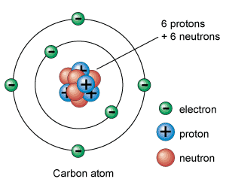
All matter is made up of atoms.
The particles that make up atoms are
Protons
Neutrons
Electrons
Protons and Neutrons are found in the nucleus. Electrons are in motion in the space around the nucleus.

Slide 3
An element is a pure substance that consists of one type of atom.
The known elements are arranged in a chart called the Periodic Table.
Atoms of the same element that differ in the number of neutrons are called isotopes. Some isotopes are radioactive and their nuclei break down and release particles and/or radiation.
Examples – Carbon-12, Carbon-13, Carbon-14
(See Miller, Levine, p. 36)

Slide 4
Isotopes have the same number of electrons so all the isotopes of an element behave in the same way and have the same chemical properties.
Ions are positively or negatively charged atoms. Some atoms gain or lose electrons and this causes them to have a charge associated with them.
Ex. Sodium (Na) loses one electron so it becomes Na⁺ It now has 11 protons, 12 neutrons, and 10 electrons.

Slide 5
A compound is a chemical substance that is formed by the combination of two or more elements in a definite ratio (CO₂ has 2 oxygen atoms for every 1 carbon atom).
The properties of compounds are different from the elements that form them.
Atoms of elements in compounds are held together by chemical bonds.

Slide 6
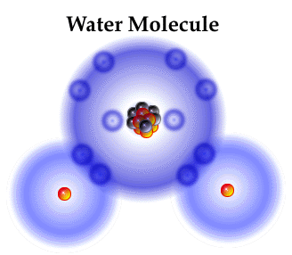
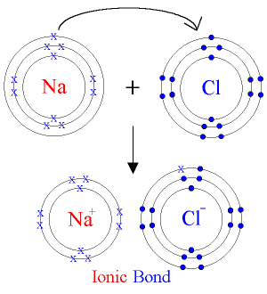
An ionic bond is formed when one or more electrons are transferred from one atom to another.
A covalent bond is formed when electrons are shared between atoms.
Covalent Bond

Slide 7
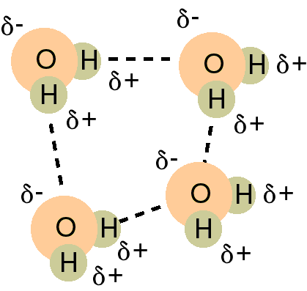
Water molecules are polar because the hydrogen and oxygen atoms share electrons unequally. The oxygen atom has a greater attraction for the electrons so they spend more time around the oxygen nucleus. The oxygen atom has a partial negative charge and the hydrogen atoms have a partial positive charge.

Slide 8
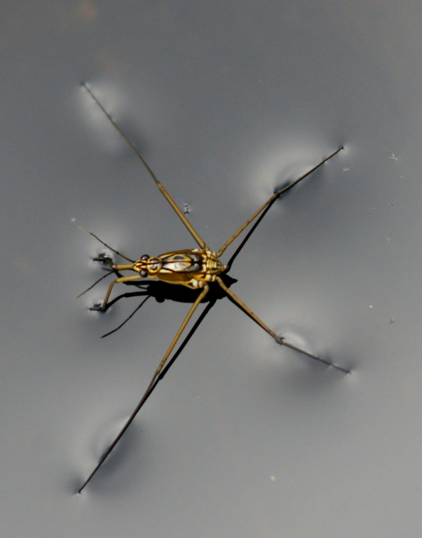
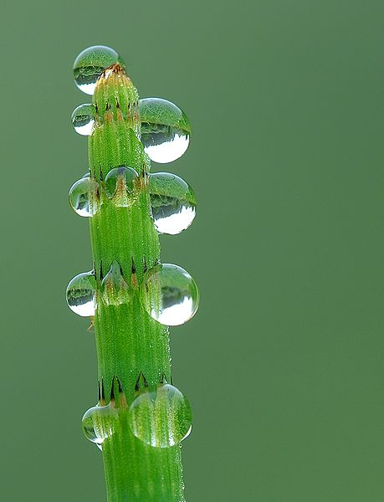
Adhesion vs. Cohesion
Cohesion is the attraction between molecules of the same substance. Because of hydrogen bonding, water is very cohesive.
Adhesion is the attraction between molecules of different substances.

Slide 9
Mixtures
A mixture is a material made up of two or more elements or compounds physically together in the same container but not chemically combined
Ex. Salt and pepper, tossed salad, salt water
Solutions are mixtures in which the components are evenly distributed.
Solute – substance that is dissolved (salt)
Solvent – substance in which the solute dissolves (water)
Suspensions are mixtures that contain a liquid and undissolved particles that eventually may settle out.

Slide 10
Acids and Bases
Acids are solutions that contain higher concentrations of H⁺ ions than pure water and have pH values below 7.
Bases are solutions that contain lower concentrations of H⁺ ions than pure water and have pH values greater than 7.
pH scale ranges from 0 to 14 with 7 being neutral.

Slide 11
Buffers are weak acids or bases that can react with strong acids or bases to prevent sharp, sudden changes in pH. Buffers in our bodies help to control pH levels and maintain homeostasis.

Slide 12
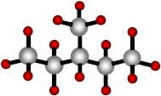
Chemistry of Carbon

Slide 13
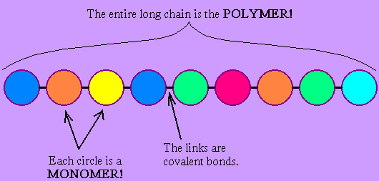
Many molecules in living cells are very large and are called macromolecules. These molecules are formed when individual units called monomers are joined together to form polymers.

Slide 14
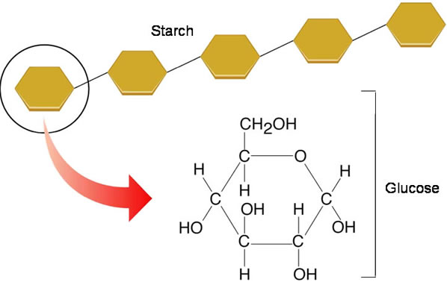
Four groups of organic compounds (containing hydrogen and carbon) found in living things are carbohydrates, lipids, nucleic acids and proteins.
Carbohydrates are used by living things as their main source of energy.

Slide 15
Monosaccharides are single sugar molecules. Examples include glucose, galactose (found in milk), and fructose (found in fruits).
Polysaccharides are formed by linking together monosaccharides in long chains.
Plants store excess sugar as a polysaccharide called starch. Plants also make another polysaccharide called cellulose that forms the cell walls of plant cells and gives them strength and rigidity.

Slide 16
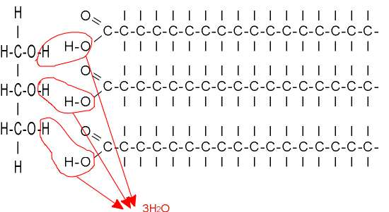
Lipids include fats, oils, and waxes. They can be used to store energy. Some lipids are important parts of biological membranes and waterproof coverings.
Many lipids are formed when a glycerol molecule combines with compounds called fatty acids.

Slide 17
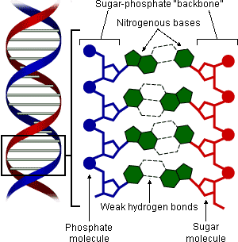
Nucleic acids are polymers made from individual monomers called nucleotides. Nucleotides contain a 5-carbon sugar, a phosphate group, and a nitrogenous base.

Slide 18
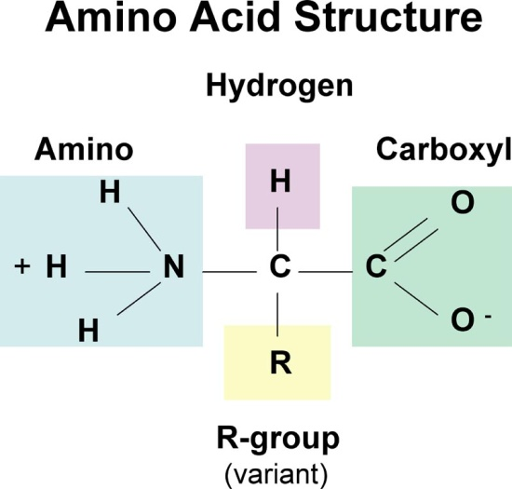
Nucleic acids store and transmit hereditary, or genetic, information. There are two kinds of nucleic acids: RNA and DNA.
Proteins are polymers of molecules called amino acids. Amino acids are compounds with an amino group (-NH₂ ) on one end and a carboxyl group (-COOH) on the other end.

Slide 19
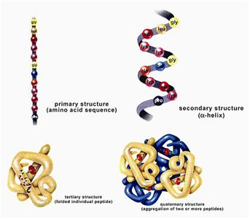
Some proteins control the rate of reactions and regulate cell processes. Some are used to form bones and muscles. Others transport substances into or out of cells or help fight disease.

Slide 20
Chemical reactions are processes that change one set of chemicals into another set of chemicals.
Reactants are the elements or compounds that enter into a chemical reaction.
Products are the elements or compounds that are formed by the chemical reaction.
Chemical reactions always involve the breaking of bonds in reactants and the formation of new bonds in products.

Slide 21
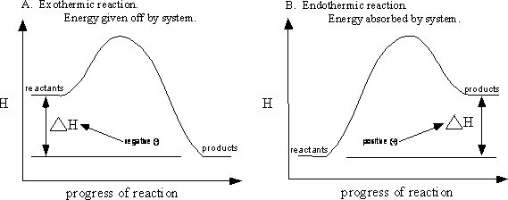
Chemical reactions that release energy (exothermic) often occur spontaneously. Chemical reactions that absorb energy (endothermic) will not occur without a source of energy.

Slide 22
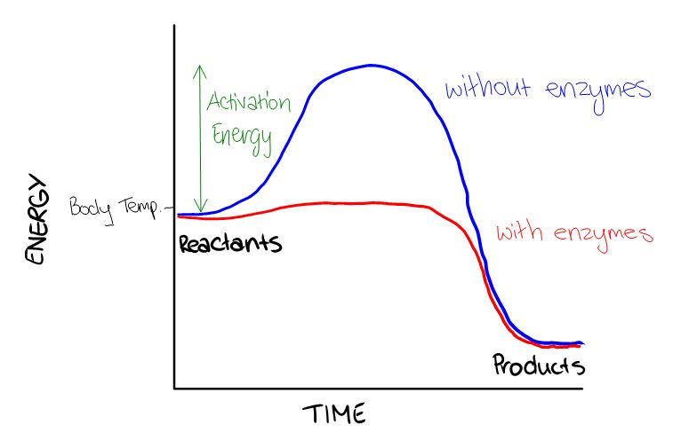
A catalyst is a substance that speeds up the rate of a chemical reaction.
Enzymes are proteins that act as biological catalysts.
Cells use enzymes to speed up chemical reactions that take place in cells.

Slide 23
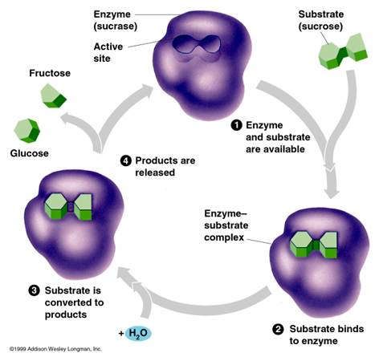
Enzyme Action

Slide 24
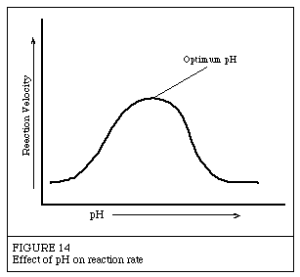
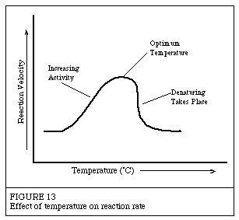
Enzymes are affected by pH levels and temperature.

